Slide 1

Synthetic Data Generation
Niya Maria Noby
Data Science Intern

Slide 2

CONTENTS
Introduction
Objective of Project
Algorithm Used
Libraries Used
Model summary
Analysis
Advantages & Disadvantages
Future Scope
Conclusion

Slide 3
Synthetic Data Generation
In the era of deep learning, high-quality labeled datasets are crucial for training robust models.
Synthetic data generation is an approach used to create artificial datasets that mimic real-world data.
This project focuses on generating synthetic handwritten digits using the MNIST dataset and deep learning models like Generative Adversarial Networks (GANs).

Slide 4
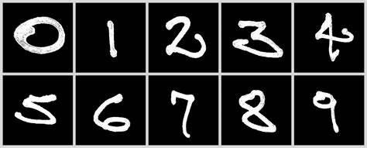
MNIST DATASET
A classic dataset for image recognition tasks, widely used for benchmarking machine learning models.
Features:
Images: 28x28 grayscale images of handwritten digits.
Classes: 10 classes, representing digits 0-9.
Size: 60,000 training images and 10,000 test images.
Use Case: Ideal for beginners in machine learning and
deep learning, especially for image classification models.

Slide 5

Objective of Project
Improve data availability for training deep learning models.
Enhance model performance by augmenting
real datasets with synthetic data.
Evaluate the quality of generated data by
comparing it to the original MNIST dataset

Slide 6
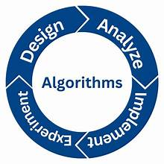
Algorithm Used
Algorithm: Convolutional Neural Network (CNN)
Conv2D Layers: Extracts spatial features from images using 32 and 64 filters.
MaxPooling2D Layers: Reduces spatial dimensions,
preserving essential features.
Flatten Layer: Converts the 2D feature maps into
a 1D vector.
Dense Layers: Fully connected layers helps in
classification (128 neurons, output 10 classes).

Slide 7
Pipeline
Data Preprocessing:
Load MNIST dataset.
Normalize pixel values to a [0, 1] range.
Reshape input to match CNN input dimensions (28x28x1).
Model Architecture:
Input: 28x28x1 grayscale images.
Layers: Convolutional, MaxPooling, Flatten, Dense.
Model Compilation:
Optimizer: Adam.
Loss Function: Sparse categorical crossentropy.
Metrics: Accuracy.
Model Training:
Train for 100 epochs with training and validation data.
Results Visualization:
Plot training and validation accuracy over epochs.

Slide 8
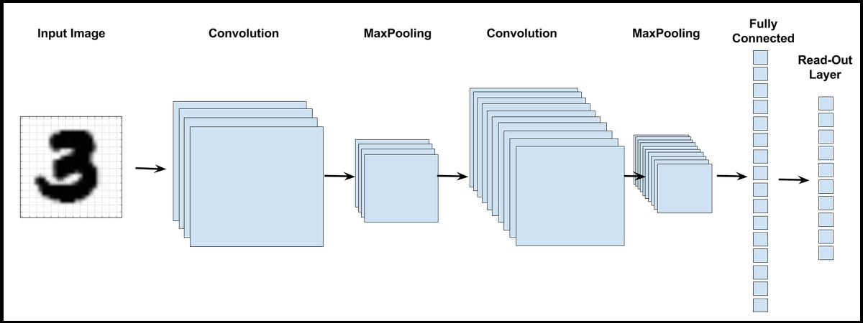

Slide 9
Synthetic Data Generation Using GANs
To generate Synthetic MNIST digits we used to Generative Adversarial Networks(GANs).It consists of two neural networks.
Generator- Creates new images that resemble MNIST digits.
Discriminator- Tries to distinguish real MNIST digits from synthetic ones.
Both network compete, improving the quality of synthetic digits over time.

Slide 10
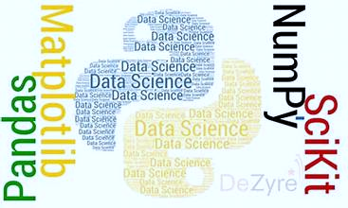
Libraries Used
Deep Learning Libraries: TensorFlow, Keras, PyTorch.
Data Handling: NumPy, Pandas.
Visualization: Matplotlib
Image Preprocessing: OpenCV
Convert text to Speech: gTTS
Deployment: Gradio for interactive
model demo

Slide 11
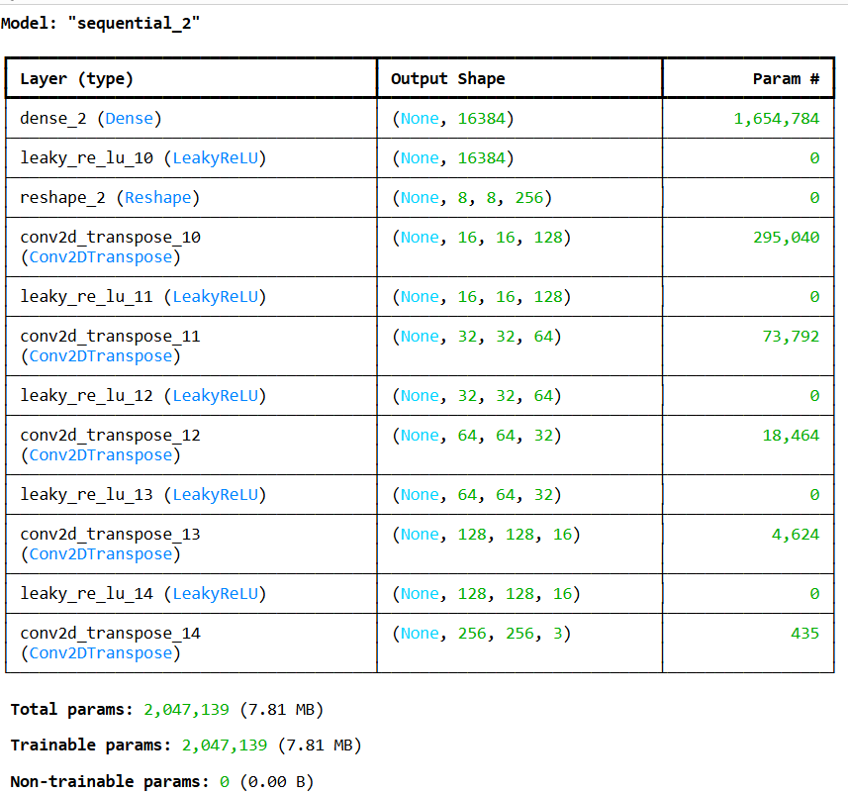
Model Summary

Slide 12
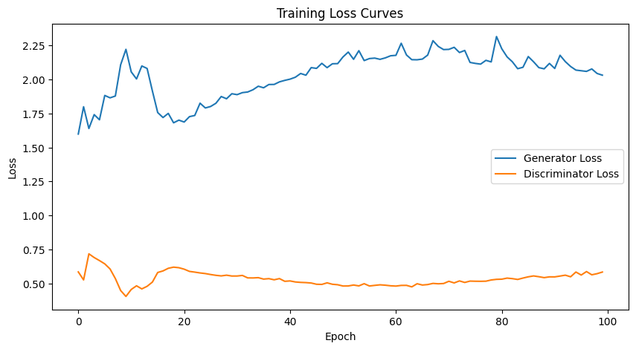
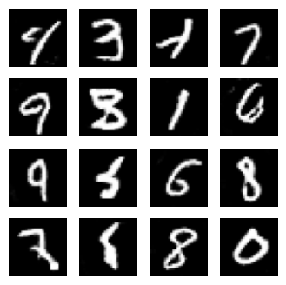
Analysis

Slide 13
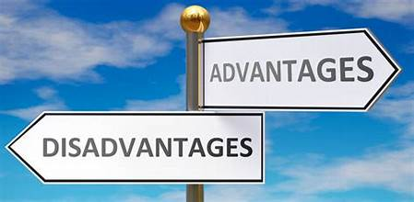
Advantages & Disadvantages
Advantages:
Improved Model Generalization
Privacy-Preserving Data
Facilitates Research & Experimentation
Disadvantages:
Quality Dependency on Generation Methods
Requires a large dataset for better
generalization.

Slide 14

Future Scope
Extending synthetic data generation
to other datasets (e.g., medical imaging,
autonomous driving).
Improving GAN architectures for
higher-quality synthetic data.
Exploring few-shot learning techniques
to further minimize data dependency

Slide 15

Conclusion
Synthetic data plays a vital role in deep learning.
GANs can effectively generate and classify MNIST digits, contributing to better model training and augmentation strategies.
Future improvements can enhance dataset quality and model performance.

Slide 16


